Slide 1
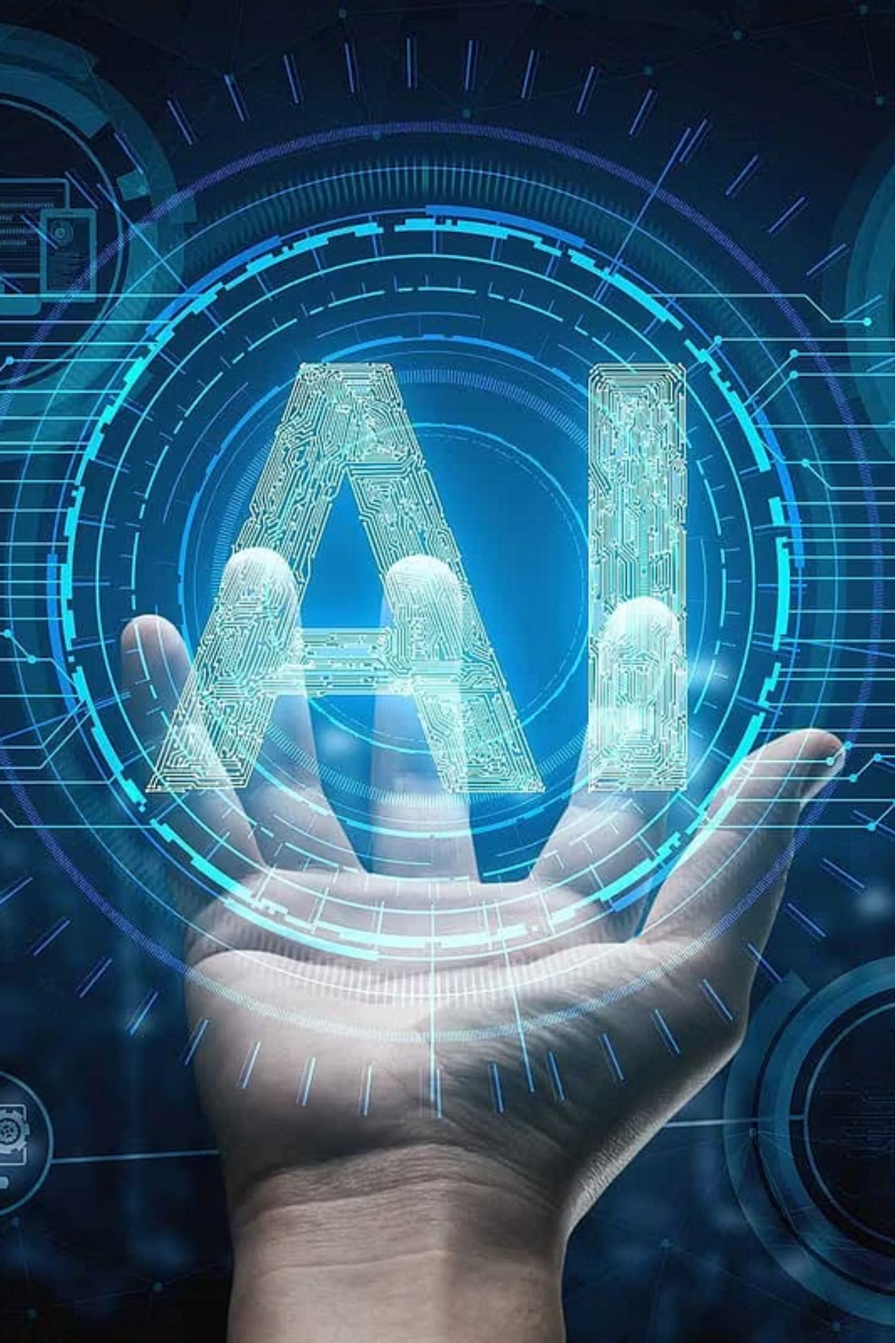
Assignment 03 – Emerging Technologies & Career Exploration
Artificial Intelligence (AI) is one of the most influential and rapidly expanding domains of technology. It allows machines to perform tasks that typically require human intelligence, such as learning patterns, making decisions, understanding language, and recognizing images. AI systems work by processing data, identifying trends, and improving their performance over time through feedback.
K.R. MANGALAM UNIVERSITY
B.Tech CSE (AI-ML)
Name: Subhranil Dutta
Roll No: 2501730179
Section: B
Submitted To: Mr. Aryan Sharma

Slide 2

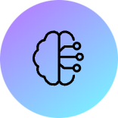



Unpacking Artificial Intelligence
AI allows machines to learn, decide, understand, and recognize, mimicking human intelligence. It processes data to identify trends and improve performance over time.
Learning Patterns
Decision Making
Language & Recognition
AI systems excel at identifying complex patterns within vast datasets.
Algorithms empower machines to make informed choices.
From voice assistants to image recognition, AI bridges human-machine communication.

Slide 3

Key Technologies Powering Modern AI
Foundations & Model Families
Core Frameworks & Libraries
Cloud & Production: Scaling AI
Transformers & LLMs: Dominant architecture for text, vision, and multimodal models, powering GPT-style generation and BERT-style understanding.
PyTorch: The go-to for research and production deep learning with dynamic graphs and strong GPU support.
Data Primitives
TensorFlow: A mature, production-grade ML ecosystem widely used in industry.
GPU/TPU Acceleration
Generative Models: Fuel creative tasks like code, image, and video generation through autoregressive LLMs and diffusion models.
Hugging Face / Transformers: Provides easy access to pretrained LLMs, central to NLP workflows.
Distributed Training
Model Monitoring
Cloud ML & Managed Platforms
MLOps & Production Tooling
Major cloud vendors like AWS SageMaker, Google Vertex AI, and Microsoft Azure ML offer managed training, deployment, and MLOps for enterprise AI, continuously adding LLM-focused features.
MLOps stacks (MLflow, Kubeflow, DVC, Airflow) are crucial for experiment tracking, reproducible pipelines, and safe production rollouts. Over 85% of production failures are due to operational gaps, highlighting MLOps' importance.

Slide 4
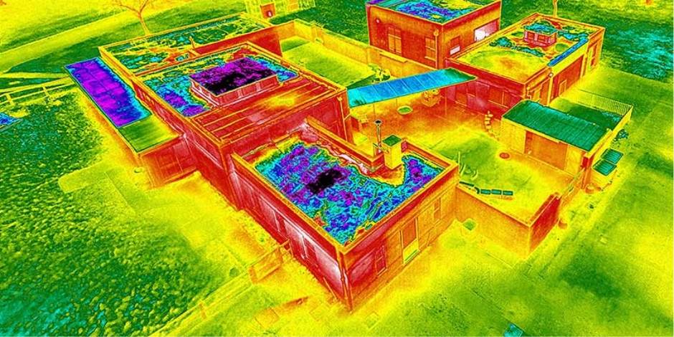
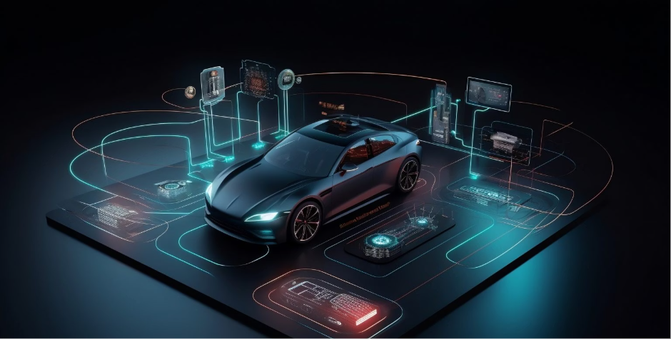
DISTINGUISED EXAMPLES-
Indian example — AI in medical screening & diagnostics (Niramai, Qure.ai, SigTuple)
Global example — Autonomous driving & perception (Waymo / Tesla / Waymo/DriveGPT examples)
Startups like Niramai use AI-based thermal imaging + deep learning for low-cost breast-cancer screening (non-invasive, radiation-free) — typical pipeline: sensor image → pre-processing → CNN/transformer-based model → risk score for follow-up. This is a strong example of AI addressing an India-specific need (affordable, scalable screening). Government & hospitals are collaborating with such startups to extend reach.
Companies like Waymo and Tesla use large perception stacks (camera/LiDAR/radar fusion), real-time neural nets for detection, planning systems and simulation-driven training. These systems combine sensor fusion, reinforcement learning / imitation learning for decision making, and heavy simulation for safety testing. The autonomous vehicle example highlights complex real-time AI, safety engineering and edge deployment.
Generative AI for code (Copilot-style), content creation and knowledge work automation.

Slide 5

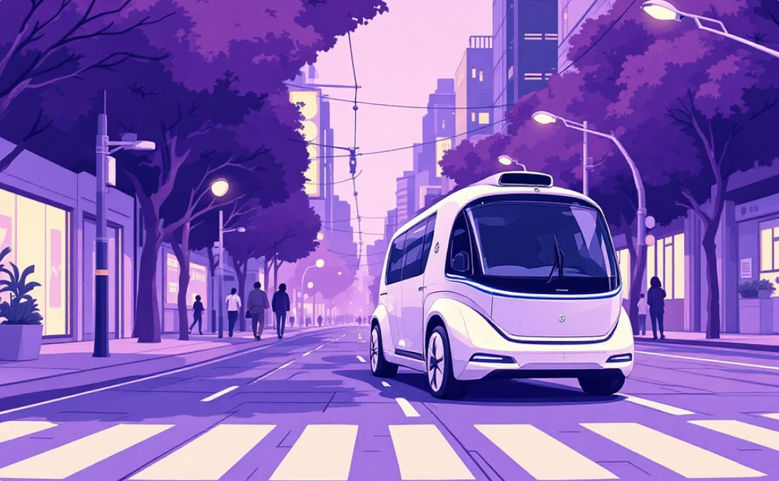
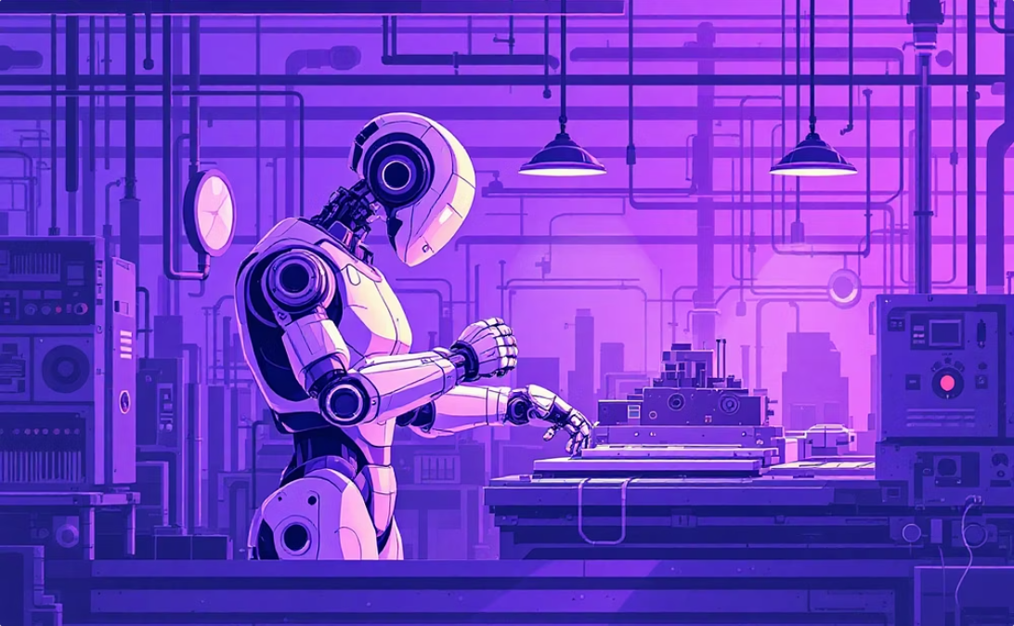
Real-World AI Applications
AI is transforming industries, from healthcare to transportation, with innovative solutions.
Medical Screening & Diagnostics
Autonomous Driving
Predictive Maintenance
Companies like Waymo and Tesla deploy sophisticated AI for real-time perception, planning, and safety testing using sensor fusion and neural networks.
Startups like Niramai use AI for low-cost, non-invasive breast cancer screening in India, integrating thermal imaging with deep learning.
AI optimizes manufacturing and supply chains through computer vision and time-series models.

Slide 6

AI Career Opportunities: Demand & Roles
Global and Indian hiring for AI specialists has surged, with significant year-on-year increases in job postings.
1
2
3
ML / Deep Learning Engineer
Data Scientist
MLOps / Platform Engineer
Formulates problems, performs EDA, feature engineering, and communicates business impact.
Builds and trains models, implements architectures, writes production-grade code.
Builds CI/CD for models, deployment pipelines, and monitoring.
4
5
Research Scientist (AI)
Prompt Engineer / LLM App Engineer
Develops new models/algorithms, often in startups or big tech research teams.
Crafts prompts, builds instruction-tuned agents, and fine-tunes LLMs.

Slide 7
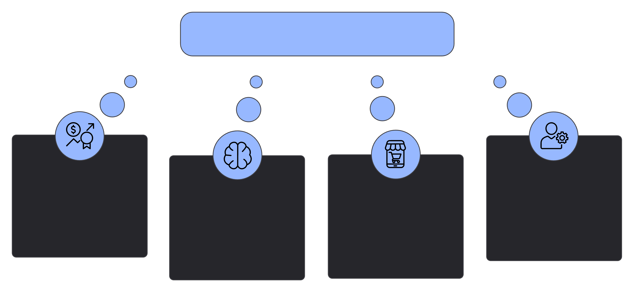
REFLECTION:
Reflection (200–300 words) Artificial Intelligence has always attracted me because of its ability to replicate human-like intelligence and solve complex real-world problems. While completing this assignment, I gained a clearer understanding of how AI works, its wide range of technologies, and how deeply it influences our everyday lives—often without us realizing it. From simple tasks like recommending videos to advanced processes like detecting diseases, AI plays a major role in shaping modern society. This motivates me to explore the field further, as it aligns with my passion for technology and innovation. Some skills I currently possess—such as basic programming knowledge, curiosity about new technologies, and an interest in understanding digital systems—serve as a good foundation for entering the AI domain. However, I aim to develop stronger capabilities in machine learning, Python programming, mathematics (especially statistics and linear algebra), and deep learning. I also want to gain experience with AI tools and cloud platforms, which are widely used in industries today. Overall, this assignment strengthened my desire to build a career in Artificial Intelligence. I believe AI has the potential to create meaningful solutions that benefit society, and I aspire to contribute to such advancements in the future. Working in this domain will not only allow me to grow professionally but also enable me to be part of the technological evolution shaping tomorrow’s world.
Artificial Intelligence
Motivation to Explore AI
Needed Technical Skills
Human-like Problem Solving
Everyday AI Impact

